Slide 1
Writing to Passage Based Prompts Across Content Areas

Slide 2
Start with the standards: ELA, History/Social Studies; Science and Technical Subjects 6-12
Key Ideas and Details
Read closely to determine what the text says explicitly and to make logical inferences from it
Cite specific textual evidence when writing or speaking to support conclusions drawn from the text

Slide 3
It’s elementary my dear Watson… First find the central ideas of the text and then look for the key details that support them!
Where’s the evidence Sherlock, you know, the textual kind?

Slide 4
Reading Like A Detective
Reporting Like A Writer

Slide 5
Making Good Decisions
Step 1: Find appropriate supplementary texts in your content area
Step 2: Choose a text that is worthy of “READING LIKE A DETECTIVE,” i.e., would enhance your content
Step 3: Identify main/central idea(s) and supporting evidence, i.e., key details
Step 4: Bullet supporting evidence to make sure text has sufficient “meat” to include in response
Step 5: Create appropriate Writing Situation and Writing Directions
Step 6: Create Scoring Rubric

Slide 6
Appropriate Audiences and Writing Purposes
Informal audience:
Peers, friends, relatives
Formal audience:
Principal, Teachers, City Officials, etc.
Inform; Explain; Describe
Narrate for a purpose of informing, etc.
Give opinion/argue

Slide 7
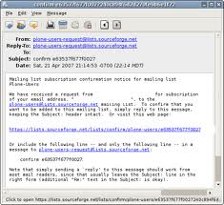
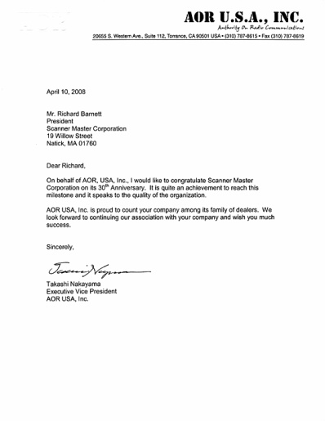
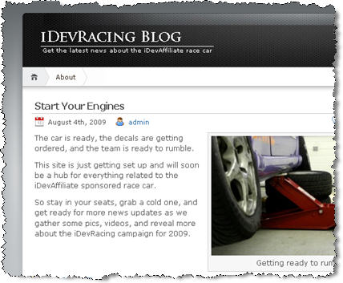
LETTER TO CITY OFFICIAL
ARTICLE
E-MAIL
Forms
CLASSROOM BLOG
LETTER TO EDITOR
LOCAL NEWS STATION BLOG
LETTER TO NEW STUDENT
Notes:
6th Grade K-PREP letter to editor giving argument about whether students should be paid to do well in school
5th grade K-PREP article for new student’s notebook about celebrations that honor past and present members of the American Armed forces
8th grade article to be published on local news station’s blog – argument to support need to control invasive plants

Slide 8
U-F-A-P IT!
SCHOOL-WIDE APPROACH
to prompted writing

Slide 9
“Hot Potato Issue” – Time Life For Kids
WRITING SITUATION: Even though schools are “still free to pass the potato,” your School District’s Nutritionist is planning to reduce the number of servings of potatoes with school lunches each week. Before she does so, however, she would like to know your opinion about the “Hot Potato Issue.”
WRITING DIRECTIONS: After reading the article and thinking about your own food preferences, decide what you think about limiting potato servings in schools and write an email to your School District’s Nutritionist to explain your opinion. Be sure to use textual evidence from the article to support your opinion.

Slide 10
U-F-A-P IT!
Underline key words ! Use in introduction
Form? Email - Formal
Audience? School District’s Nutritionist
Purpose? Explain my opinion about reducing number of potato servings with school lunches each week

Slide 11
Underline Key Words
WRITING SITUATION: Even though schools are “still free to pass the potato,” your School District’s Nutritionist is planning to reduce the number of servings of potatoes with school lunches each week. Before she does so, however, she would like to know your opinion about the “Hot Potato Issue.”
WRITING DIRECTIONS: After reading the article and thinking about your own food preferences, decide what you think about limiting potato servings in schools. Then write an email to your School District’s Nutritionist to explain your opinion. Be sure to use textual evidence to support your opinion.

Slide 12
Identifying main ideas and Textual Evidence
PRO POTATO LIMIT (2 SERVINGS PER WEEK):
Children get enough potatoes already
Children should try other veggies
CON POTATO LIMIT:
Potatoes good source of fiber and potassium
Many schools already prepare french fries in healthier way
USDA should not tell schools what to serve but should advise how to prepare food in healthier way

Slide 13
Use Key Words in Intro
To: School District’s Nutritionist
Subject: Limiting potato servings
I have read the “Hot Potato Issue” article and am writing about your plan to reduce the number of servings of potatoes with school lunches each week even though schools are “still free to pass the potato.” As a potato lover, I am happy that the U.S. Senate has blocked a USDA proposal to limit potato servings in schools, but I am unhappy with the plan to reduce the number of servings.
my opinion

Slide 14
Complete writing task
According to the text, potatoes are “a good source of fiber and potassium.” The text also states “many schools already prepare french fries with less grease and serve potatoes in healthier recipes.”
On the other hand, as I have heard my mother say many times, too much of a good thing can be bad for you. So my suggestion is that you continue to give us the same number of potato servings with our school lunches. However, to make sure they are healthier, maybe they could be baked instead.

Slide 15
Conclusion
As a student, I appreciate being asked for my opinion about the “hot potato issue.” From what I have noticed at lunch time, there are many students who are potato lovers. This makes me think that there will be many unhappy students if potatoes are limited. On their behalf, as well as mine, I hope you will consider my suggestion to continue to offer french fries and that they are baked instead of fried. Thank you.

Slide 16
Scoring Rubric – Main Criteria
Establishes/maintains authentic purpose
Addresses an appropriate audience
Establishes/maintains awareness of audience’s needs
Develops ideas
Elaborates with textual evidence; cites appropriately, e.g, According to. . .; The author stated. . .; From the reading, I discovered. . .
Maintains coherence; uses transitions
Uses writing conventions correctly

Slide 17
Text Sources
ReadWorks.org
Content area magazines
Time for Kids
ProCon.org
WordGeneration.org
Newsela.org

Slide 18
Jennifer Bernhard
District Literacy Specialist
Clark County Schools
Winchester, KY 40391
Jennifer.bernhard@clark.kyschools.us
http://teach.clarkschools.net/jbernhard/literacy_web/

